Slide 1
When Central Offices Help Principals Grow as Instructional Leaders
What’s data got to do with it?
Meredith I. Honig
Associate Professor, Ed. Leadership, Organizations & Policy
Director, District Leadership Design Lab
WEBINAR prepared for The Bill & Melinda Gates Foundation
Leading for Effective Teaching project
March 19, 2014
Notes:
REDO
Thank you Max. I am pleased to be here. I have had the great pportunity to work with school districts for almost 20 years, as a support partner and researcher. In my various roles I have worked with central office leaders all across the organization who consistently tell me and show me two things: (1) they are deeply committed to doing their part to help schools serve all students well. Most recently, what some of them mean by serving schools is that they want to help principals be successful at leading for better instruction in every classroom. (2) They don’t always have the information they need to get better at what they do in support of schools. For example, they are hungry for information about what best practices are for central office staff and some regular data to tell them if they are on the right track. But too often that information is in short supply. Or they have so much information but not the time to sort through what is and isnt useful. As one CO leader told us, “There’s just so much information and a real data collection opportunity. And I just havent had the capacity” to be able to incorporate those data into decisions. But they were, in their words, “always working” to find the right information and the right amount of time to use it.
This webinar is about those two interrelated issues: What we know about how central offices help principals grow as instructional leaders and what data and really, well developed performance management systems, have to do with helping central offices actually get better at principal support.

Slide 2



Outline
Transform into school support systems
Build true performance
management
systems
Tackle barriers: Lack of clarity, data, support
Engage leadership
tools, and systems
COs that focus on principal support
  What do they do?
  How do data matter?
What’s so hard about it?
What’s next?
Notes:
Agenda
I’m going to share with you the big picture of what we found– that they engage in fundamental or whole sale change. We call it transformation. With the word transformation we aim to signal that what these districts do is not just about making the central office more efficient or responsive but moving it toward providing better quality supports to schools with principal support as a main focus for the whole system. One of the important aspects of our work is that we move beyond broad brush findings such as central offices need a vision to elaborate what staff do day to day when their work matters for results in schools. However in this format..
Real performance management systems are essential.
But districts also face significant barriers to working well with data. Today I will highlight three…
From our work helping districts move to better performance we are learning the importance of districts tacking these barriers head on by dedicating leaders to address them and working with new tools and systems. Outside partners can help but by helping central office leaders lead the work themselves.
I’ll conclude by pointing you to some of the resources we have now and are making available to you to help your system move in those directions.

Slide 3
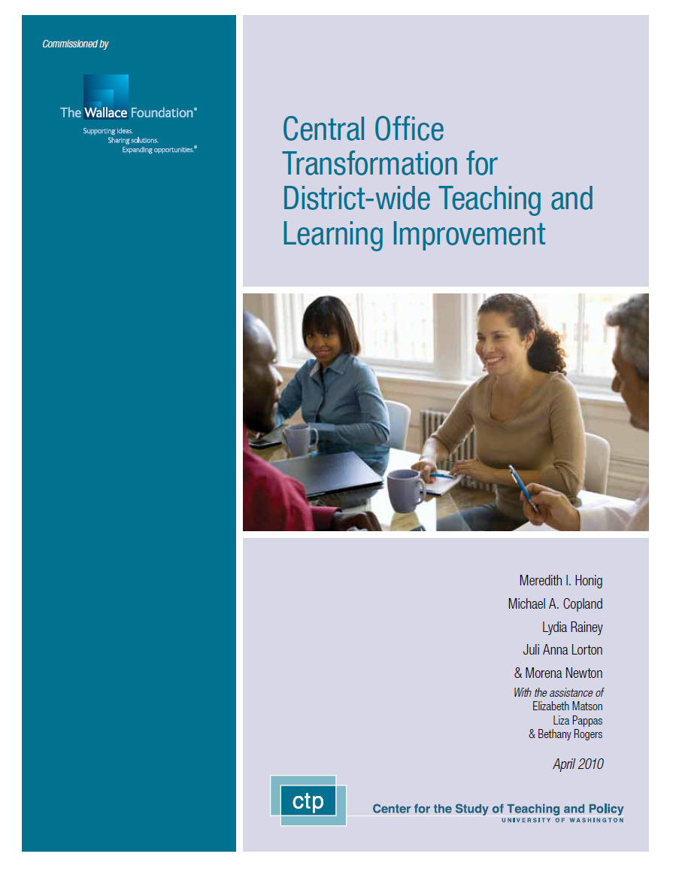

How do we know?
Selected Partnerships
Districts
  Boston, MA
  Highline, WA
  Seattle Public Schools, WA
  Gates Foundation Effective Teaching Sites
District Networks
  No. CA Superintendents
  Idaho (statewide)
Research
Teaching
UW Leadership
for Learning
Program
Notes:
Im here as a researcher…
-Observation heavy
-Strict standards of evidence

Slide 4
Outline
Transform into school support systems
Build true performance
management
systems
Tackle barriers: Lack of clarity, data, support
Engage leadership
tools, and systems
COs that focus on principal support
  What do they do?
  How do data matter?
What’s so hard about it?
What’s next?
Notes:
In their own words, what they were doing was a major transformation of the central office.

Slide 5
In their words…
“When I arrived… it was clear that our goal had to be nothing less than a total district transformation.”
We aim “to retool the entire district to support instruction and leadership in the buildings.”
“This is not your father’s or your grandfather’s old school system.”
Notes:
They take seriously the view that getting central offices to support principals as instructional leaders and districtwide teaching and learning more broadly is a far cry from central office as usual.

Slide 6

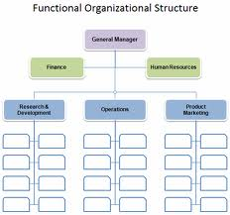
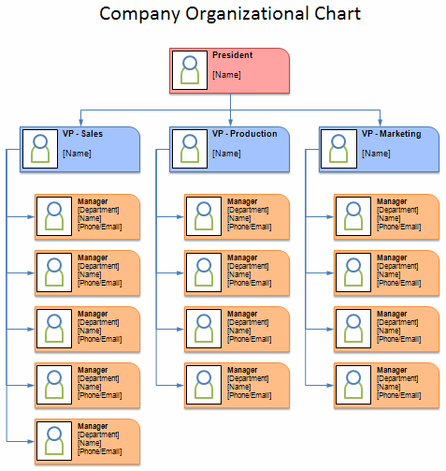
True Transformation

Slide 7

COT Theory of Action
All Principals
Excellent
Instructional
Leaders
#1 Learning-
focused
Partnerships
#2 High-quality relevant, differentiated services
Instructional
Leadership
Directors
High-quality teaching
In every classroom
All Students Achieving
at High Levels
#3 Leading by teaching & learning
Notes:
** Daniel for some reason the graphic wont fade in and fade out, which is what I want. The system flips it to one or the other. Can you fix?
Started from a theory of action tying the work of every single adult in the system to improving results for students in terms of their learning.

Slide 8
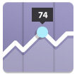

True Performance Management
Meaningful…
Measures
Supports for Using Data to Improve
Notes:
REDO:
True performance management systems were essential drivers of this work. We know this from other research and experience too across private business, the health care industry, higher education and other areas that shows the importance of data and learning from experience to help organizations build their capacity to realize results.
True performance management is not just any kind of data system or data driven decision making.
Starts with meaningful measures– in simple terms, the right things measured with the right data. Too often– despite all the push in federal and state policy for data driven deciion making--the only data staff have available to them are school test scores and maybe some program evaluation information. But what are central office staffing doing day to day and how well is it working to help school principals and teachers realize improvements in t and l for all students? Most central office staff I meet are operating with out these basic anchors to their practice: clear definitions of what their own practice should be when what they do matters to the improvement of T and L in schools and how close they are working toward that goal.
Second, true PM sustems don’t simply generate data. They provide staff with supports for using the data to get better. As one leader put it, “It’s been a long time since I’ve been in a place where people invite that kind of criticism (meaning data-informed analysis of their work) and see it as an avenue for your growth.”
Let’s look at a couple of examples together – of how these systems were transforming to better support principals and ultimately t and l and how true performange management mattered to the process

Slide 9

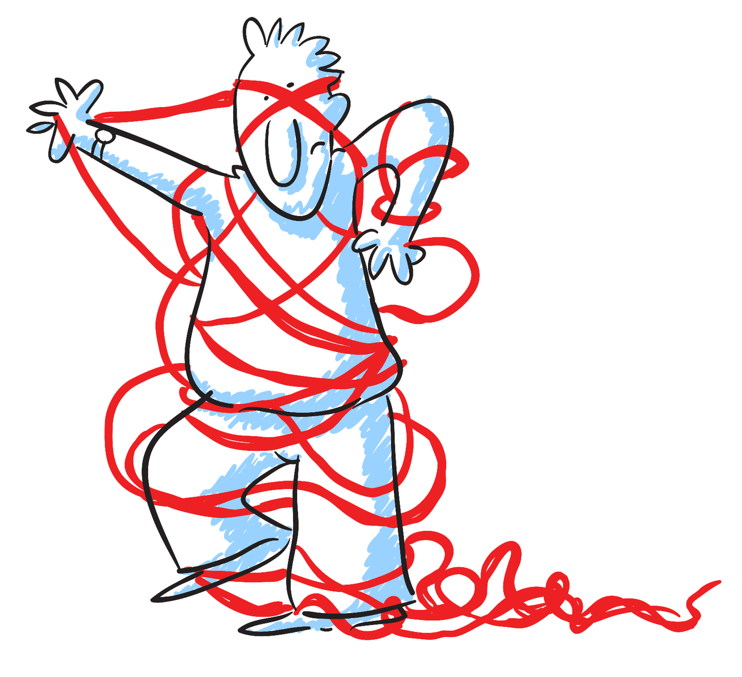
#1 Learning-focused Partnerships
Principals before…
-
… during
Partnership with ILDs focused on growth
Notes:
REDO– and I also changed the slide
First, our districts were trying to wrap new supports around principals to help them be successful. We have written a great deal about this strand of the work and you can learn mcuh more through our publications and also an online course available on our website. But in a nutshell these systems were concerned that principals were buried in red tape at the bottom of the district hierarchy in ways that frustrated their ability to lead for better instruction. Principal supervision was typically limited to check ins and evaluations not supports that promised to help principals learn how to operate ably as instructional leaders.
Our districts aimed to tackle this problem head on by redesiging the role of the principal supervisor so that the supervisor and principal were partners in helping principals grow as intsructional leaders. We found this new type of supervision had three features that were important to increasing supports for principal growth.
-Dedicated to princiapl growth. Not loaded on with other responsibilities. When they were, it took too much time away.
-Executive level. The whole point was that this wasn’t routine coaching but a shrinking of the bureaucracy.
-Mots important, teaching stance.
We distinguish PSs who work in these ways by calling them ILDs.

Slide 10
Meaningful Measures & Supports in
#1 Principal-ILD Partnerships
Measures
Clear definition: Principal instructional leadership
Multiple data sources about principal practice
Clear definition: ILD practice
Multiple data sources about ILD practice
Supports
Role definitions
Data about practice
Systems for data tracking and analysis
Case-based coaching, led internally
Notes:
Redo– and I also changed slide text and transitions
True PM was important to these relationships. Remember, true PM involves having clear role definitions/standards of working that they could tie to improving T and L. Also the right data for measuring progress.
A clear definition of the principalship as instructional leadership was an essential support for helping ILDs be successful. Makes intuitive sense– how can you help someone get better at their work if you don’t have a clear sense of what better is. We were able to back that good sense up with evidence. ILDs we associated with positive results related t principals growth worked from at least their own clear conception of wat it meant for their principals to operate as ILDs and they made that definition explicit in their work with pricipals. Those that we assocaited with negligible or negative results generally did not use a clear and consistent definition of PIL to anchor their work.
They also looked a multiple sources of evidence to inform their thinking about principals’ capacity and growth. For sure they were looking at test scores. But they were also routinely observing and documenting how principals went about their work and observing and documenting the quality of teaching in their principals schools as other proximate indicators of principal performance.
For example, several ILDs in one district regularly gathered and used evidence about their principals development as instructional leaders. This evidence included school scores on standardized tests but also their own observations for example of how principals prioritized their time on teaching and learning and their principals ability to observe and analyze teachers during classroom observations. One ILD showed us a sort of data dashboard they created for themselves in excell to track their observations of their principals practice. Along the left were elements of their defintiion of instrucitonal leadership that they were tracking over time. Populated it with various observational data about their prncipals engagement in such IL activities as working well with data to assess teaching quality.
As one superintendent recently reflected to me about the importance of such evidence of practice, Many in my community look at the high test scores in this region of our district and assume there’s no problem because test scores are high. But I go into those classrooms and the students arent truly learning, problem solving, the rigor isnt there. That’s because the teachers arent teaching powerfully and principals arent leading in ways that help them.
2. ILDs, especially those who we associated with positive results, worked from at least their own clear conception of *their* role as a teacher of principals and consulted multiple data sources to understand the extent to which they were successful. For example, in one district across interviews we picked up significant conflict among ILDs and between ILDs and their supervisors about the role of the ILDs in supporting principals. Several ILDs broke through this conflict by develop their own definition of success, often measured in terms of the quality of the learning experience they created for principals. They cosluted mutlipe data sources to inform their thinking including: principal feedback, their own observations of principals progress, their reflections on the quality of their own work, and consultations with their colleagues. The clear role definition and regular cosultation with data provided an important anchor for their work, helping to keep them focused on the right work and continuously improving their practice. By contrast other ILDs who didn’t work in this PM way tened to get side tracked with other demands and, as each academic year wore on, to spend less time working with thir principals.
As you can hear from this discussion, key supports fo rworking in these ways included:
-Role defintions, not just test scores but data about adul tpractice, and systems for tracking and analysing data over time.
-Professional development that helped ILDs track and analyze data and figure out what to do was also helpful. We call tis case-based coaching because the sessions tha teemed mots helpful started with concrete examples of work ILDs were doing with school principals, the presentation of various evidence about the cases, much like coaches of sports teams review game footage to anlayze what has been happening and what they might do differently
Mattered if the faclitator was internal or external. Much more engagement and impact in the PD run by capable district leaders rathe rthan contracting out.
recent school performance assesments and a principal satisfaction survey by asking ILDs to bring other evidence of the quality of their work with principals to inform the conversation. ILDs explained they found the sessions important. All the ILDs in this district referred to this and other support form their spervisor as vital to their success. .. By contrast, another district turned all their PD over to an outside organization. Ran similar activities. But unlike the supervisor in the other district who had access to various information and made it available during th esessions, outside consultant had to rely on the IlD to bring the information, and they didn’t always. Some just didn’t seem engaged. Also didn’t build internal capacity.

Slide 11


#2 Performance-oriented Services
  #2 Shifting everyone’s work so that all staff provide high-quality, differentiated relevant services in support of instructional improvement
(The Right Work)
Notes:
DANIEL– need to get this back in.
Redesign and alignment of rest of the central office was essential.
Consider what it would be like to be a principal supervisor trying to help principals become better ILs when HR hiring and evaluation standards are not on the same page. When the instructional services unit … When budget and buildings and grounds …
Pursing alignment in a particular way….
For example…

Slide 12
An Example:
Instructional Services Transformation
C & I (“Before”)
Administers programs largely based on funding
Little coherence or synergies
No central office performance data
Instructional Services (“After”)
Transparent menu of tiered services likely to realize results
ILDs-Principals draw on services to support professional learning goals
Staff continually assess their own performance
Notes:
REDO
During transormatin process, they were challenging themselves to provide only those services they thought would matter to performance
REVIEW
We saw these ways of working in units all across the central office including buildings and grounds and nutrition services:
Staff figuring out how to align what they actually do school support, using real data of impact, and continuously assessing their own individual performance

Slide 13
Meaningful Measures & Supports in
#2 Performance-oriented Services
Measures
Defined quality work as supporting principals to improve teaching quality
Consulted multiple data sources
  Test scores
  Principal and ILD satisfaction
  Practice data
  Research
Supports
“Score card” processes based on theory-of-action principles
Access to practice data
Opportunities for sense-making
Notes:
As I hope you can hear in the example of IS, true PM was essential to these new ways of working
-CO staff took time to define what they thought they needed to do to improve T and L. Really challenged to make a logical connection. Not always easy. E.g. HR signatures. But it’s the wrong work.
Also hope you hear its not juts about looking at test scores or asking principals what they needed. I see many districts to base what services they rpovide base don what principals say they want. But what princpals want isnt always what’s going to get them to results.
-Score card processes bsaed on t of a principles. In simple terms, each unti an deach staff person had what some districts called a score card that spelled out what they thought they needed to be doing day to day to realiez results. And what their interim and ultimate targets were going to be to measure their progress and success.
-Access to practice data.
-Sensemaking- Nutrition example.
So I have talked about #1 and #2. We elarboate on these findings and also data use in #3 in our publications.
As one CO leader explained, alking through what data actually says and what they mean can shift the culture from blame to performance.
One of the problems with the old central office was “the lack of being data driven” That it fueled a sense that nothing was working and a culture of blame. “And the more we have data to tell our story about, well, here’s how we’re really doing and you can perceive it however you want. But actually what happens is when you start using data you start changing your perceptions of people. So that’s why I’m training my managers on how to do that and be very data driven. And be almost like a coach of a baseball team that’s usign their stats al the time.”

Slide 14
Outline
Transform into school support systems
Build true performance
management
systems
Tackle barriers: Lack of clarity, data, support
Engage leadership
tools, and systems
COs that focus on principal support
  What do they do?
  How do data matter?
What’s so hard about it?
What’s next?
Notes:
In their own words, what they were doing was a major transformation of the central office.

Slide 15
Challenges in Moving toward Performance
What are the challenges in your district?
Central office work ill-defined
Little relevant data
No help with using the data they have

Slide 16
Making it Happen
1. Self-assess
Definition of target central office practices?
  How clear? (i.e., does it actually describe what central office staff should be doing)
  How relevant to improving teaching & learning?
  How meaningful to staff?
How measured?
  Clear? Relevant? Meaningful?
Processes for helping staff use data to improve?
2. Prioritize and take action with reform design and performance management systems working together
3. Use external partners, but strategically
Notes:
Some districts are jumping right to measures without first clarifying what is the practice they want to encourage, with data and other resources.

Slide 17

Resources from External Partners
Research-based designs to inform development of central office improvement initiatives
Tools for working with performance data over time
  Processes for developing meaningful measures
  Instruments for measuring performance (e.g., scorecards)
  Strategies for looking at multiple measures of practice changes over time
3. Facilitation that builds internal leadership
capacity
Notes:
Some districts are jumping right to measures without first clarifying what is the practice they want to encourage, with data and other resources.

